Slide 1
Quantifying the Confidence of Anomaly Detectors in Their Example-Wise Predictions
Lorenzo Perini, Vincent Vercruyssen, Jesse Davis
ECML - PKDD 2020
https://people.cs.kuleuven.be/~lorenzo.perini/
@LorenzoPerini95

Slide 2
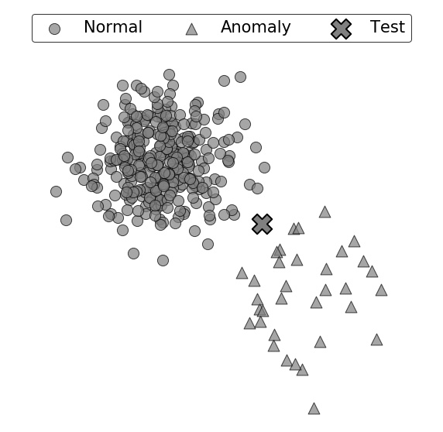
Capturing Uncertainty in Anomaly Detection
Predicted Class: ?

Slide 3
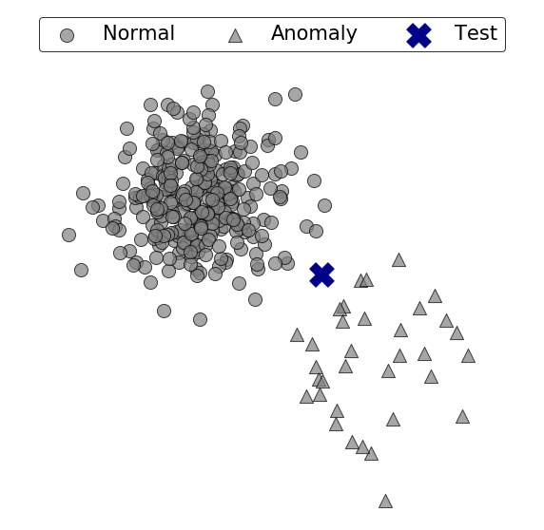
Capturing Uncertainty in Anomaly Detection
Predicted Class: Normal
Does the prediction change when a different training set is drawn from the same distribution?
How confident is the model in its prediction?

Slide 4
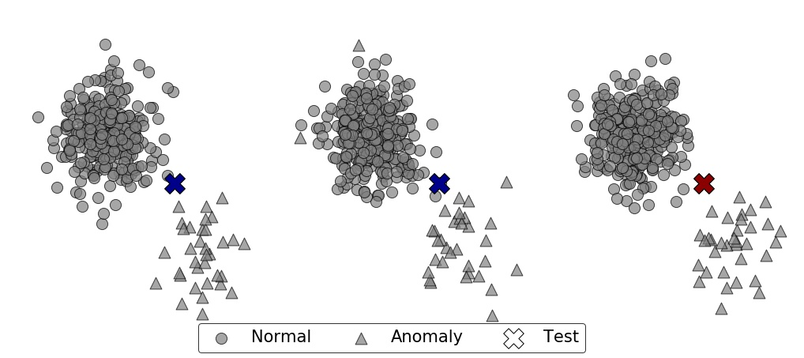
What Is the Effect of Slightly Perturbing the Training Data on Anomaly Detector’s Prediction for a Fixed Example?
Dataset 1
Dataset 2
Dataset 3
Prediction:
Normal
Anomaly

Slide 5
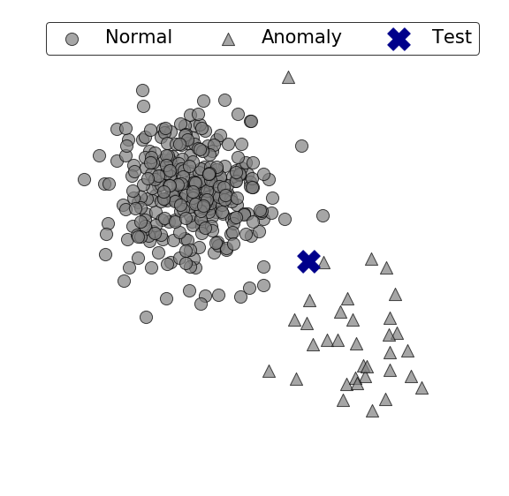
Our Goal Is To Capture the Uncertainty in Predictions
Out of 20 predictions:
50% Normal;
50% Anomaly.
Given:
An anomaly detector and a test example;
Do:
Need of a measure of confidence in predicting the same class.

Slide 6
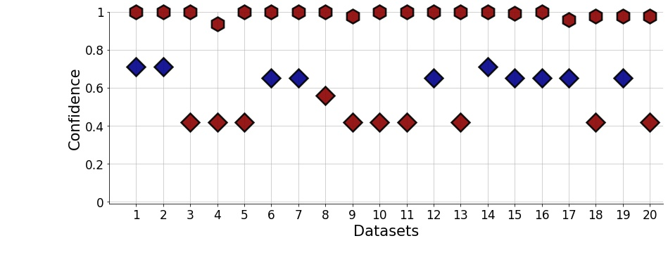
Confidence Allows Cross-Comparisons among Models
Which one would you trust more?
Prediction:
Normal
Anomaly
kNNO
IForest

Slide 7
How would you estimate the confidence of a model in its example-wise predictions?
End of the spotlight presentation

Slide 8
We Make 4 Contributions
Define the confidence in an example-wise prediction;
Propose ExCeeD: a 2-step approach for estimating the confidence:
Convert anomaly scores to outlier probabilities using a Bayesian approach;
Derive confidence scores by observing that different datasets would lead to different thresholds and, in turn, to different predictions;
Analyze the convergence behavior of our estimate;
Perform an extensive empirical evaluation on benchmark datasets.
Confidence: the probability that a detector’s prediction would change
for any fixed example if a different training set was observed

Slide 9
Contribution 1: Defining the confidence A measure of uncertainty in class prediction

Slide 10
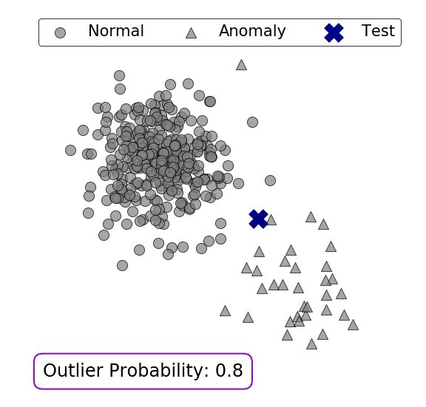
Do Density Estimators Capture Uncertainty in Class Prediction?
Prediction:
Normal
Anomaly
Although the predicted class changes many times, the outlier probability keeps being high

Slide 11
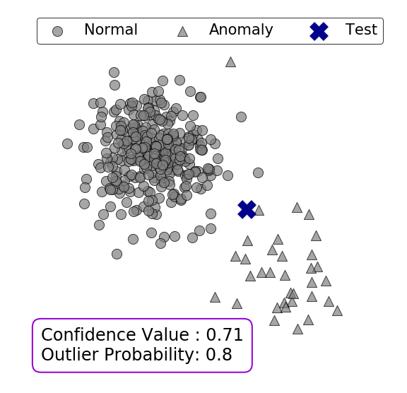
Confidence Is a Novel Measure of Consistency
Prediction:
Normal
Anomaly
When the class is Normal, the confidence is around 60%
When the class is Anomaly, the confidence is around 40%

Slide 12
Confidence Is NOT Outlier Probability because they measure fundamentally different things
Prediction:
Normal
Anomaly
Outlier probability measures the probability of belonging to the anomaly class
Confidence measures the consistency in predicting the same class

Slide 13
3 Steps of Standard Unsupervised Anomaly Detection
Unlabeled Data

Slide 14
3 Steps of Standard Unsupervised Anomaly Detection
Anomaly Scores
$$s4$$
$$st$$
$$s1$$
$$s6$$
$$…$$
$$sn$$
$$…$$
$$s5$$
Map
Unlabeled Data

Slide 15
3 Steps of Standard Unsupervised Anomaly Detection
Anomaly Scores
$$s4$$
$$st$$
$$s1$$
$$s6$$
$$…$$
$$sn$$
$$…$$
$$s5$$
Anomaly Ranking
$$s1$$
$$s2$$
$$s3$$
$$s4$$
$$…$$
$$st$$
$$…$$
$$sn$$
Map
Sort
yes
Unlabeled Data
no

Slide 16
3 Steps of Standard Unsupervised Anomaly Detection
Anomaly Scores
$$s4$$
$$st$$
$$s1$$
$$s6$$
$$…$$
$$sn$$
$$…$$
$$s5$$
Anomaly Ranking
$$s1$$
$$s2$$
$$s3$$
$$s4$$
$$…$$
$$st$$
$$…$$
$$sn$$
Map
Sort
yes
Unlabeled Data
no
Threshold $=n×γ$
($γ$ is the expected proportion of anomalies)

Slide 17
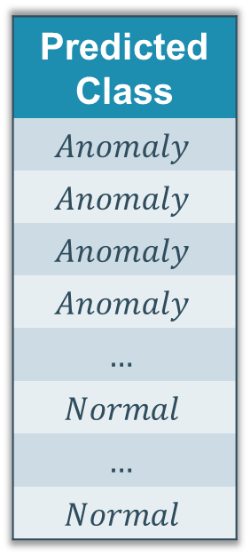
3 Steps of Standard Unsupervised Anomaly Detection
Anomaly Scores
$$s4$$
$$st$$
$$s1$$
$$s6$$
$$…$$
$$sn$$
$$…$$
$$s5$$
Anomaly Ranking
$$s1$$
$$s2$$
$$s3$$
$$s4$$
$$…$$
$$st$$
$$…$$
$$sn$$
Predicted Class
$$Anomaly$$
$$Anomaly$$
$$Anomaly$$
$$Anomaly$$
$$…$$
$$Normal$$
$$…$$
$$Normal$$
Map
Sort
Predict
yes
Unlabeled Data
no
Threshold $=n×γ$
($γ$ is the expected proportion of anomalies)

Slide 18
Contribution 2: ExCeeD A two-steps approach for estimating the confidence

Slide 19
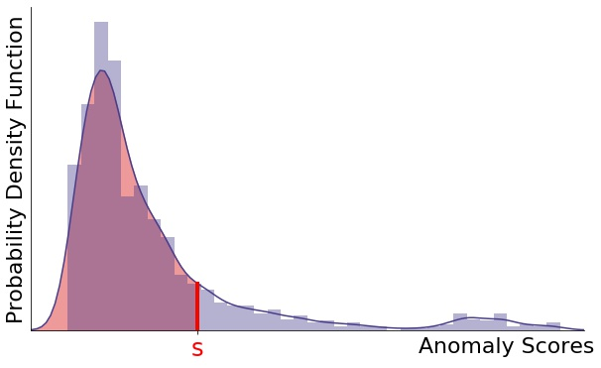
Step 1: Converting Anomaly Scores to Outlier Probabilities
The larger the number of examples with a lower anomaly score,
the more anomalous the example is.
$$ps$$

Slide 20
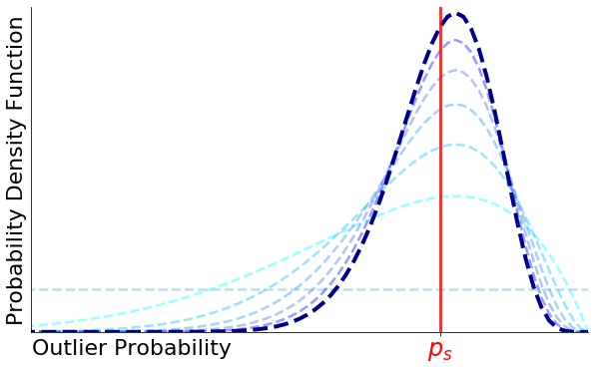
Step 1: Converting Anomaly Scores to Outlier Probabilities
The larger the number of examples with a lower anomaly score,
the more anomalous the example is.
We need a Bayesian approach because we need a smooth measurement of the area.
$$ps$$

Slide 21
Step 2: Converting Outlier Probabilities to Confidence Scores
It is only matter of whether the drawn anomaly scores are greater than s or not.
$$ps$$
$$1−$$
$$ps$$
$$ps$$

Slide 22
Step 2: Converting Outlier Probabilities to Confidence Scores
It is only matter of whether the drawn anomaly scores are greater than s or not.
$$ps$$
How many scores end up being
in the red area?
$$1−$$
$$ps$$
$$ps$$

Slide 23
Step 2: Converting Outlier Probabilities to Confidence Scores
It is only matter of whether the drawn anomaly scores are greater than s or not.
$$ps$$
How many scores end up being
in the red area?
$$1−$$
$$ps$$
$$ps$$
ExCeeD estimates the probability that ‘enough’ examples
fall inside the red area in order to keep the same prediction

Slide 24
Contribution 3: Convergence Analysis How increasing the size of the training set affects ExCeeD’s confidence estimation

Slide 25
Convergence Behavior of Our Confidence Measure
Two cases according to $γ$:
$γ≠0$: training set contains anomalies
$γ=0$: training set with no anomalies

Slide 26
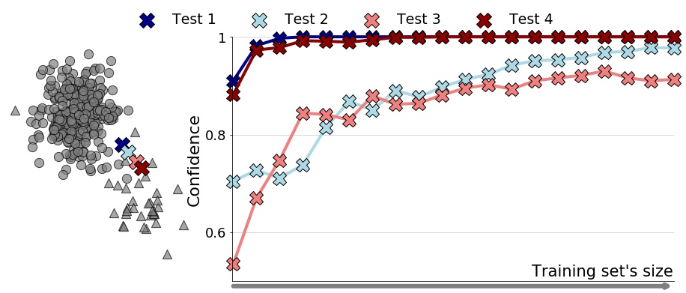
Convergence Behavior of Our Confidence Measure
Two cases according to $γ$:
$γ≠0$: training set contains anomalies
$γ=0$: training set with no anomalies
The confidence converges
to $1$

Slide 27
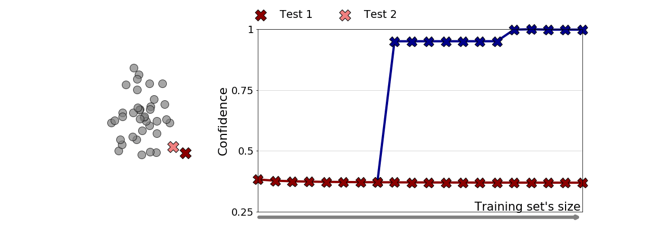
Convergence Behavior of Our Confidence Measure
Two cases according to $γ$:
$γ≠0$: training set contains anomalies
$γ=0$: training set with no anomalies
The confidence converges
to $1$
The confidence converges
to $e^{−1}≈0.3679$

Slide 28
Contribution 4: Experiments An extensive empirical evaluation on benchmark datasets

Slide 29
A Large Experimental Comparison Shows that ExCeeD Recovers Confidence Matching Empirical Frequencies
We compared ExCeeD with three types of baselines
Naive Baseline, i.e. confidence always equal to 1;
Outlier Probability methods, i.e. apply existing methods instead of step 1;
Calibration methods, i.e. calibrated probabilities assuming to get a labeled dataset;
on 21 benchmark datasets and 3 anomaly detectors, and we found that:
Our outlier probability’s estimate leads to more accurate confidence scores;
ExCeeD outperforms all the baselines, no matter of the anomaly detector used.

Slide 30
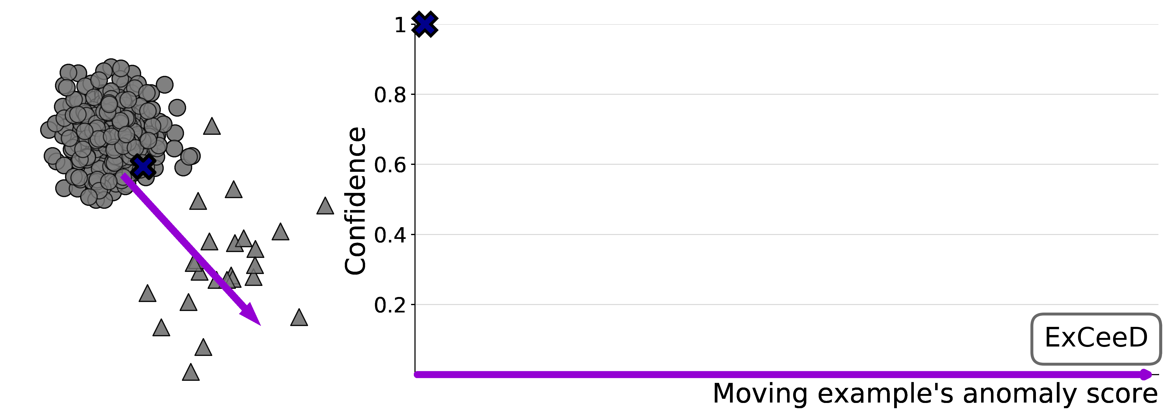
ExCeeD Captures Our Intuitions about How a Detector’s Confidence in Its Prediction Varies as this Example Moves
Prediction:
Normal
Anomaly

Slide 31
In Conclusion, ExCeeD Is Not (Only) a Density Estimator
We proposed a novel definition of confidence as the probability that the predicted class would change if a different training set was observed;
We proposed ExCeeD, a method for estimating any anomaly detector’s confidence;
We proved that ExCeeD’s estimates of the confidence converge;
Empirically, ExCeeD recovers accurate confidence scores.
All code and experiments are available online: https://github.com/Lorenzo-Perini/Confidence_AD

Slide 32
Contact us name.surname@kuleuven.be
Lorenzo Perini, Vincent Vercruyssen, Jesse Davis
ECML - PKDD 2020
https://people.cs.kuleuven.be/~lorenzo.perini/
@LorenzoPerini95

