Slide 1
Transferring the Contamination Factor between Anomaly Detection Domains by Shape Similarity
Lorenzo Perini, Vincent Vercruyssen, Jesse Davis
AAAI 2022
https://people.cs.kuleuven.be/~lorenzo.perini/
@LorenzoPerini95
Notes:
Hello and welcome to full talk about transferring the contamination factor between anomaly detection domains by shape similarity. My name is Lorenzo and this work is in collaboration with Vincent Vercruyssen and prof. Jesse Davis. We all are from DTAI lab of KU Leuven in Belgium.

Slide 2
Anomaly detectors compute anomaly scores indicating how anomalous examples are
Anomaly Scores
s₁
s₂
s₃
s₄
…
Anomaly detector
More anomalous
Less anomalous
Unlabeled data
Anomaly detection is usually tackled from an unsupervised perspective, because labels are expensive or difficult to acquire
Notes:
Let me start this talk with an overview of the classic anomaly detection setting. Anomaly detection is the task of detecting examples that do not follow an expected behaviour. Usually anomaly detection is tackled from an unsupervised perspective because labels are expensive or difficult to acquire. Therefore, an unsupervised anomaly detector exploits some intuitions to assign anomaly scores to each example that represent how anomalous the example is.

Slide 3
Converting anomaly scores to hard predictions is challenging without labels
In practice, one needs the model’s hard predictions for decision making.
Anomaly Scores
s₁
s₂
s₃
s₄
…
A common approach is to set the threshold based on the contamination factor Ɣ
Ɣ
In practice, it is the user that has to provide such a contamination factor
Threshold
Notes:
However, in practice the anomaly scores are not enough to take decisions and one needs to set a threshold on top of the scores using either some labels or the domain knowledge. Under the typical unsupervised setting, the common approach is to take advantage of the contamination factor gamma. In practice it’s the user that has to provide such a contamination factor, being based on domain knowledge.

Slide 4
Monitoring a fleet of assets makes the domain knowledge hard to acquire
Wind Turbine 1
Wind Turbine 2
Many practical scenarios involve a fleet of assets
Each asset has its own different contamination factor
It is unfeasible that the user provides all the contamination factors
How to estimate the contamination factor with “limited” domain knowledge?
Wind Turbine 3
Wind turbine 4
Notes:
In many practical scenarios this is not feasible, though. In fact, assume now that one needs to monitor a fleet of wind turbines and wants to detect blade icing anomalies on each of them. Unfortunately, each turbine has its own data distribution and especially its own contamination factor. It is unfeasible to think that the user can provide all the contamination factors, especially when monitoring many wind turbines. So, our question is: how can we estimate the contamination factor of each wind turbine by using only limited domain knowledge?

Slide 5
What we propose is to use Transfer Learning
GIVEN:
An anomaly detection model;
an unlabeled source domain with a known contamination factor;
an unlabeled target domain;
DO:
estimate the contamination factor of the target domain.
Wind turbine 1
source
Wind turbine 2
target
Contamination factor Ɣ
Task: transfer the contamination factor between related unlabeled anomaly detection domains
Notes:
What we propose is to use transfer learning. Formally, given an anomaly detection model, an unlabeled source domain with its contamination factor, and an unlabeled target domain, we want to estimate the target contamination factor. Essentially, our goal is to transfer such a contamination from the source to the target domain, assuming that the two anomaly detection domains are related.

Slide 6
How can we transfer
the contamination factor?
Notes:
So, the main question of our paper is: how can we do such a transfer?

Slide 7
This Paper Makes Four Contributions:
Introduce the problem of transferring the contamination factor Ɣ;
Propose a 4-step approach TrADe that:
computes the anomaly scores in each domain separately using the same anomaly detection algorithm;
sets the threshold on the source domain based on the given Ɣ;
estimates the target threshold by exploiting the domains similarity;
derives the target contamination factor as the proportion of scores above the target threshold.
Analyze the convergence behaviour of TrADe when increasing the target size;
Perform an extensive empirical evaluation on benchmark and real world data.
Notes:
Well, in this paper we make four contributions. First, we introduce the problem of transferring the contamination gamma. Second, we propose TrADe, able to do such a transfer in four steps. In a nutshell, TraDe first computes the anomaly scores separately for each domain, second sets the source threshold using the given source contamination factor; third, transfers the threshold from the source to the target domain by exploiting the shape similarity of anomaly scores and finally derives the target contamination factor as proportion of scores above the transferred threshold. Our third contribution is the analysis of TrADe’s convergence behaviour and finally we perform an extensive empirical evaluation both on benchmark datasets and on real world proprietary data.

Slide 8
Why is the contamination factor relevant
in anomaly detection?
Notes:
Alright, let’s now talk briefly about why the contamination factor is actually relevant in anomaly detection.

Slide 9
The contamination factor Ɣ allows to set a threshold
The contamination factor ɣ is the expected proportion of anomalies in the data.
Anomaly Scores
s₁
s₂
s₃
s₄
…
Ɣ =
More anomalous
Threshold
Less anomalous
What’s the impact of the contamination factor on the model predictions?
Notes:
The contamination factor gamma is defined as the expected proportion of anomalies in the data. Its value allows us to set the predictive threshold and transform the anomaly scores into hard predictions. For this task, one can set the threshold such that the proportion of scores above it exactly corresponds to the known contamination factor. Essentially, through the contamination we know how many anomalies to expect, and we force the model to predict the same number of anomalies. However, one may wonder what the impact of gamma is on the final predictions.

Slide 10
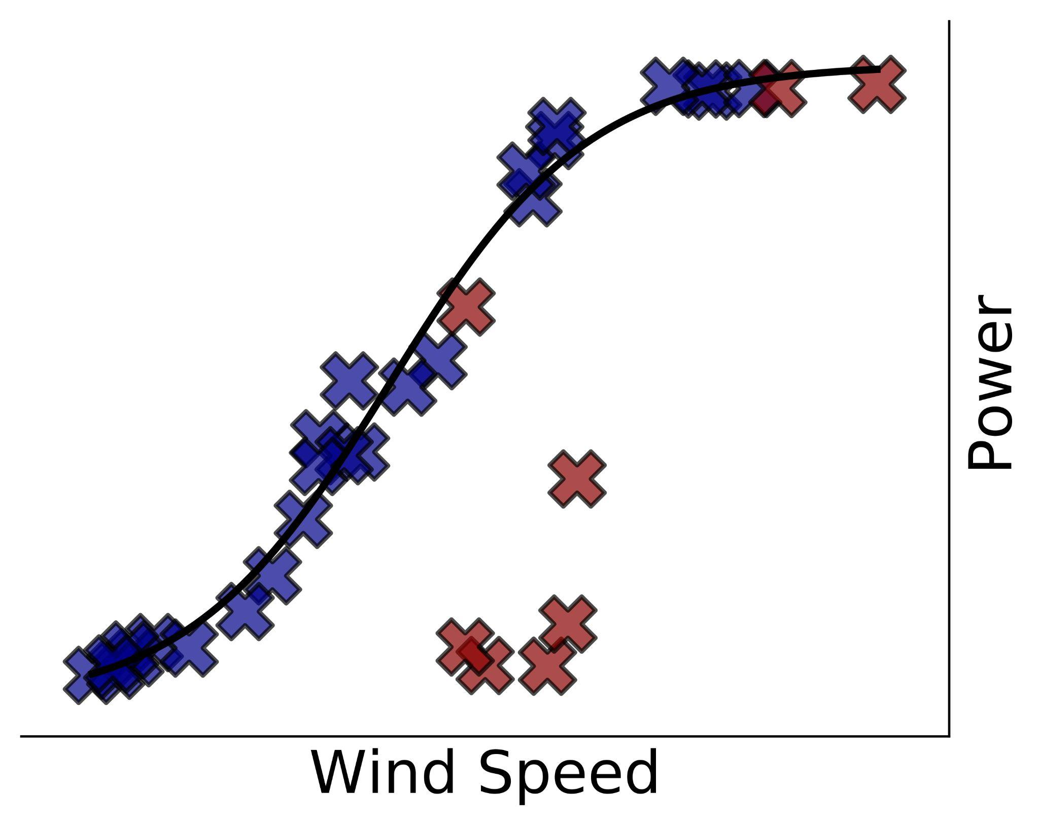
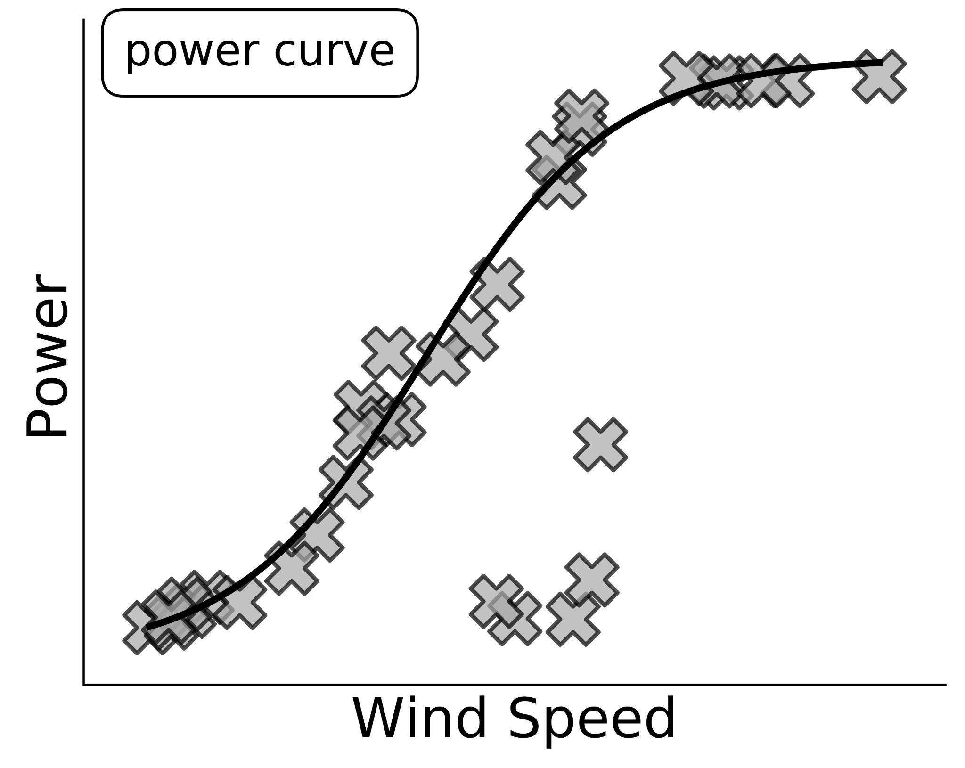
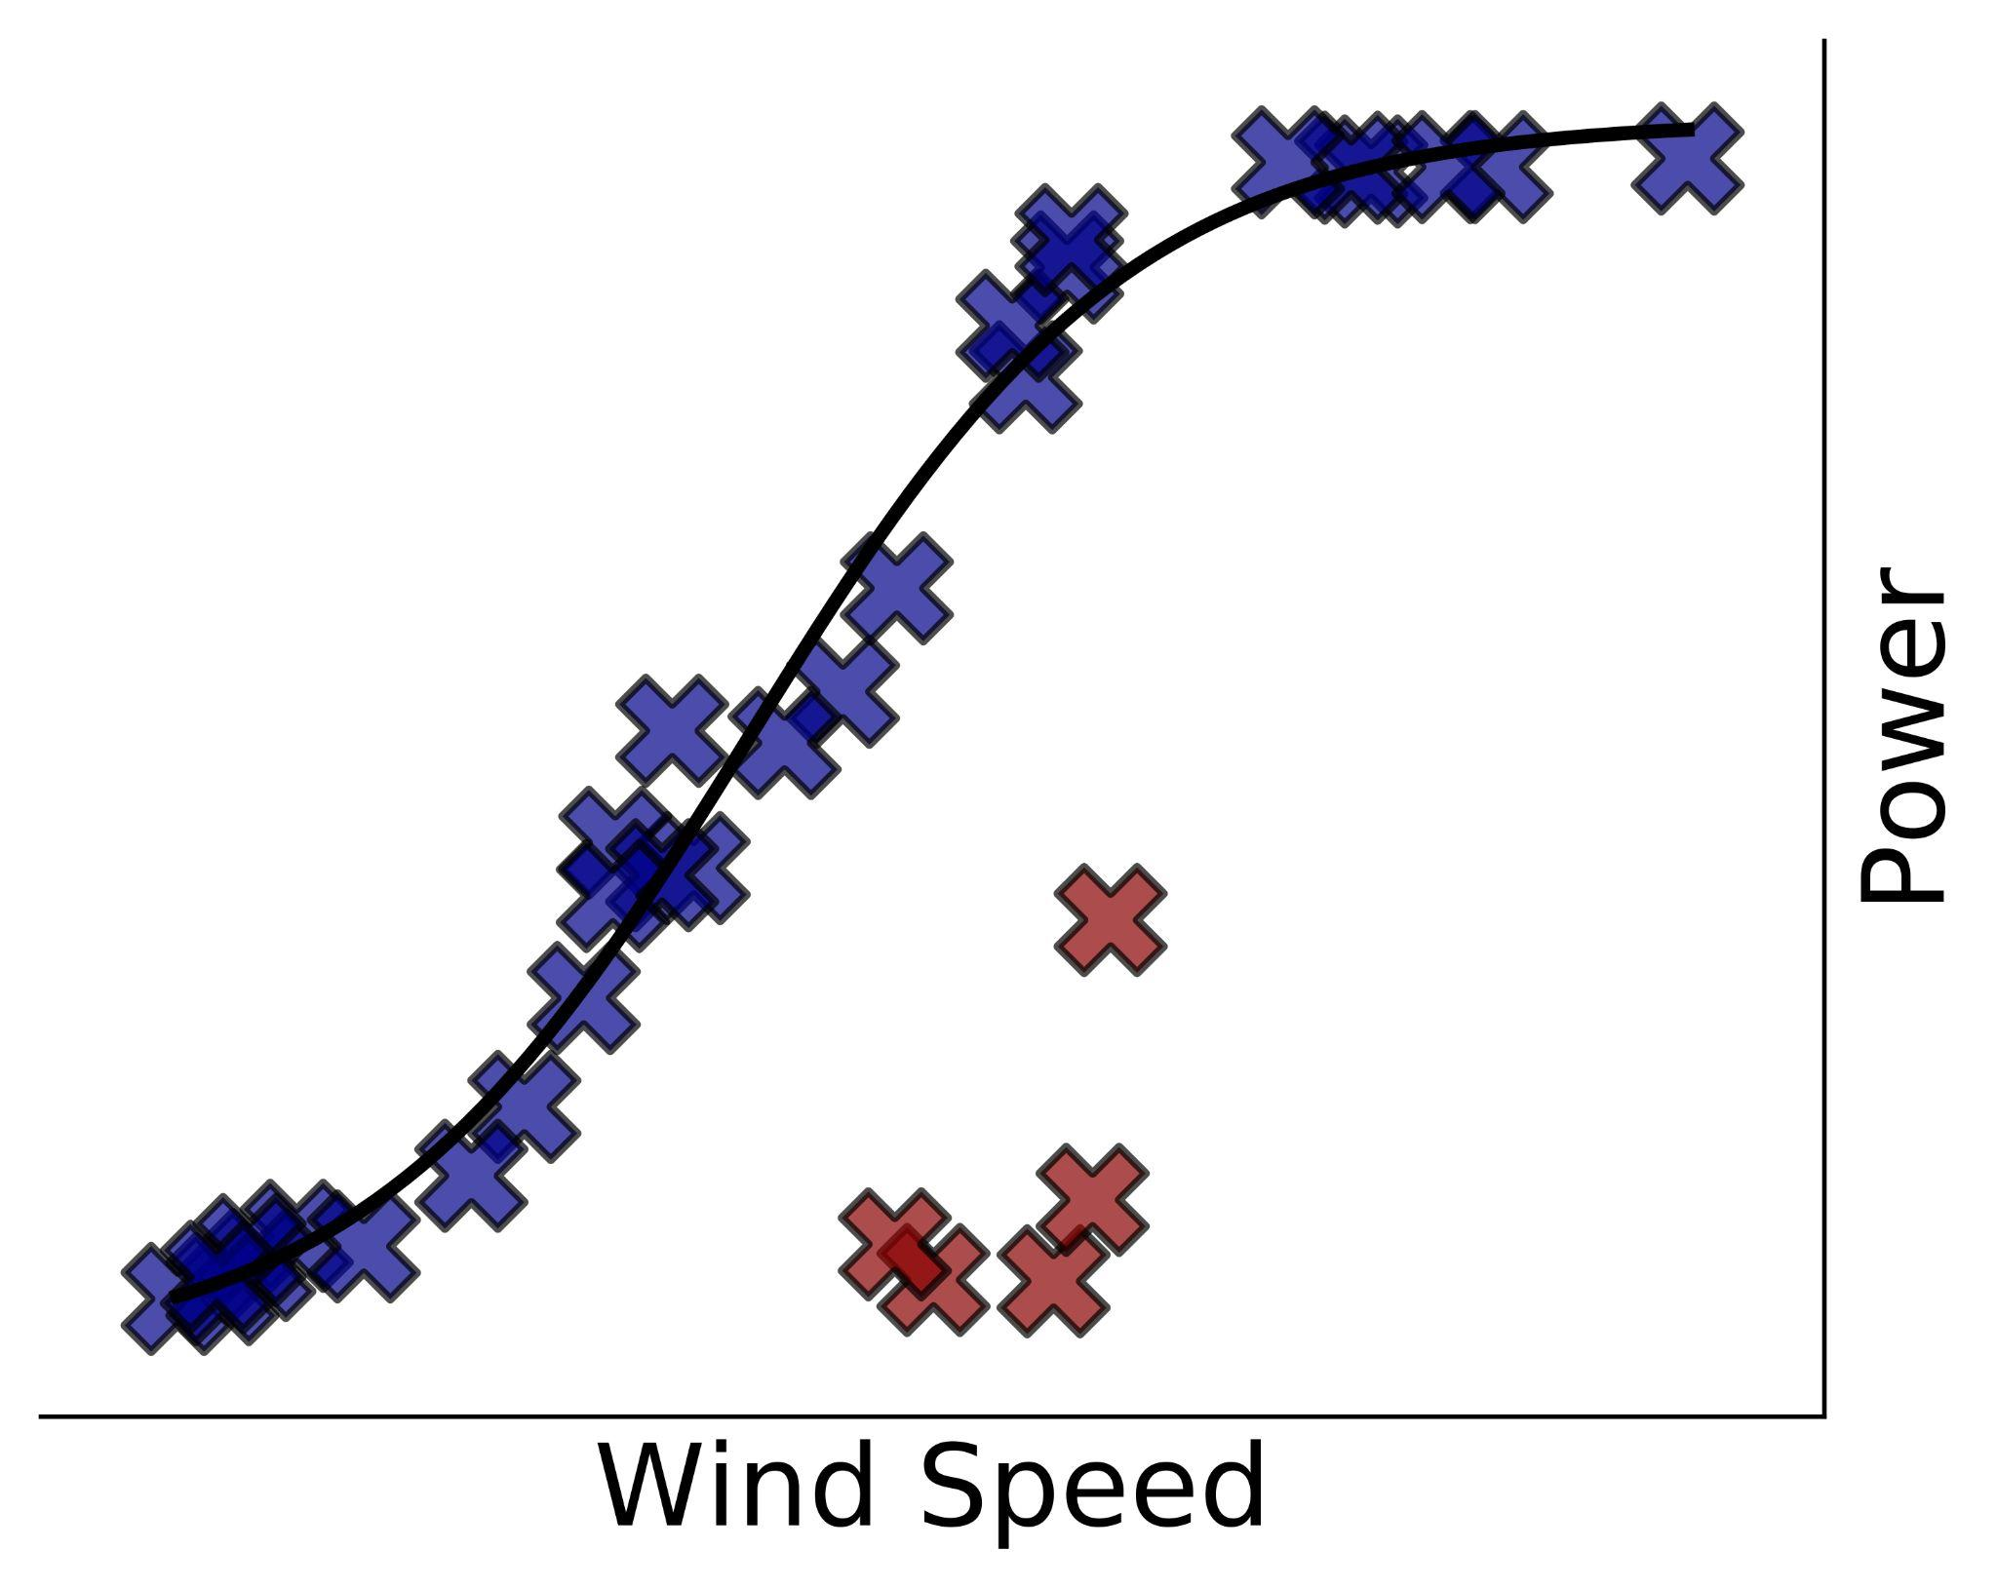
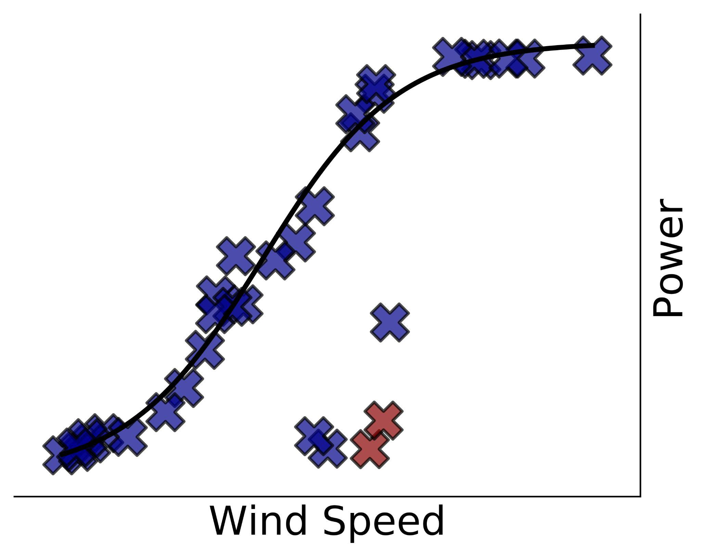
Ɣ has a relevant impact on the model performance
Three scenarios obtained by varying the contamination factor Ɣ
Scenario 1
Ɣ = 0.25
Prediction:
Normal
Anomaly
Scenario 3
Ɣ = 0.15
Scenario 2
Ɣ = 0.05
Notes:
Assume that you can collect data from a wind turbine and that your goal is to detect blade icing anomalies. As you can imagine, given a certain wind speed value the power generated by the wind turbine is lower when some ice forms on the blades. This means that the examples at the bottom of the first plot are anomalies. However, such labels are unknown to the detector as usually labels are difficult to come by. In the plots on the right, we show the results of setting the contamination factor to three different values, obtaining three different scenarios. In the first scenario, the contamination is overestimated and the model predicts some obvious normal example as anomaly, meaning high false positives. In the second scenario the contamination is underestimated and the model produces false negatives. Finally, setting the appropriate contamination results in the model predictions being correct.

Slide 11
TrADe: Transferring the contamination factor between Anomaly Detection domains
by shape similarity
Notes:
Let’s now pass to our method TrADe, that is able to transfer the contamination from two related anomaly detection domains. TrADe works in four simple steps.

Slide 12
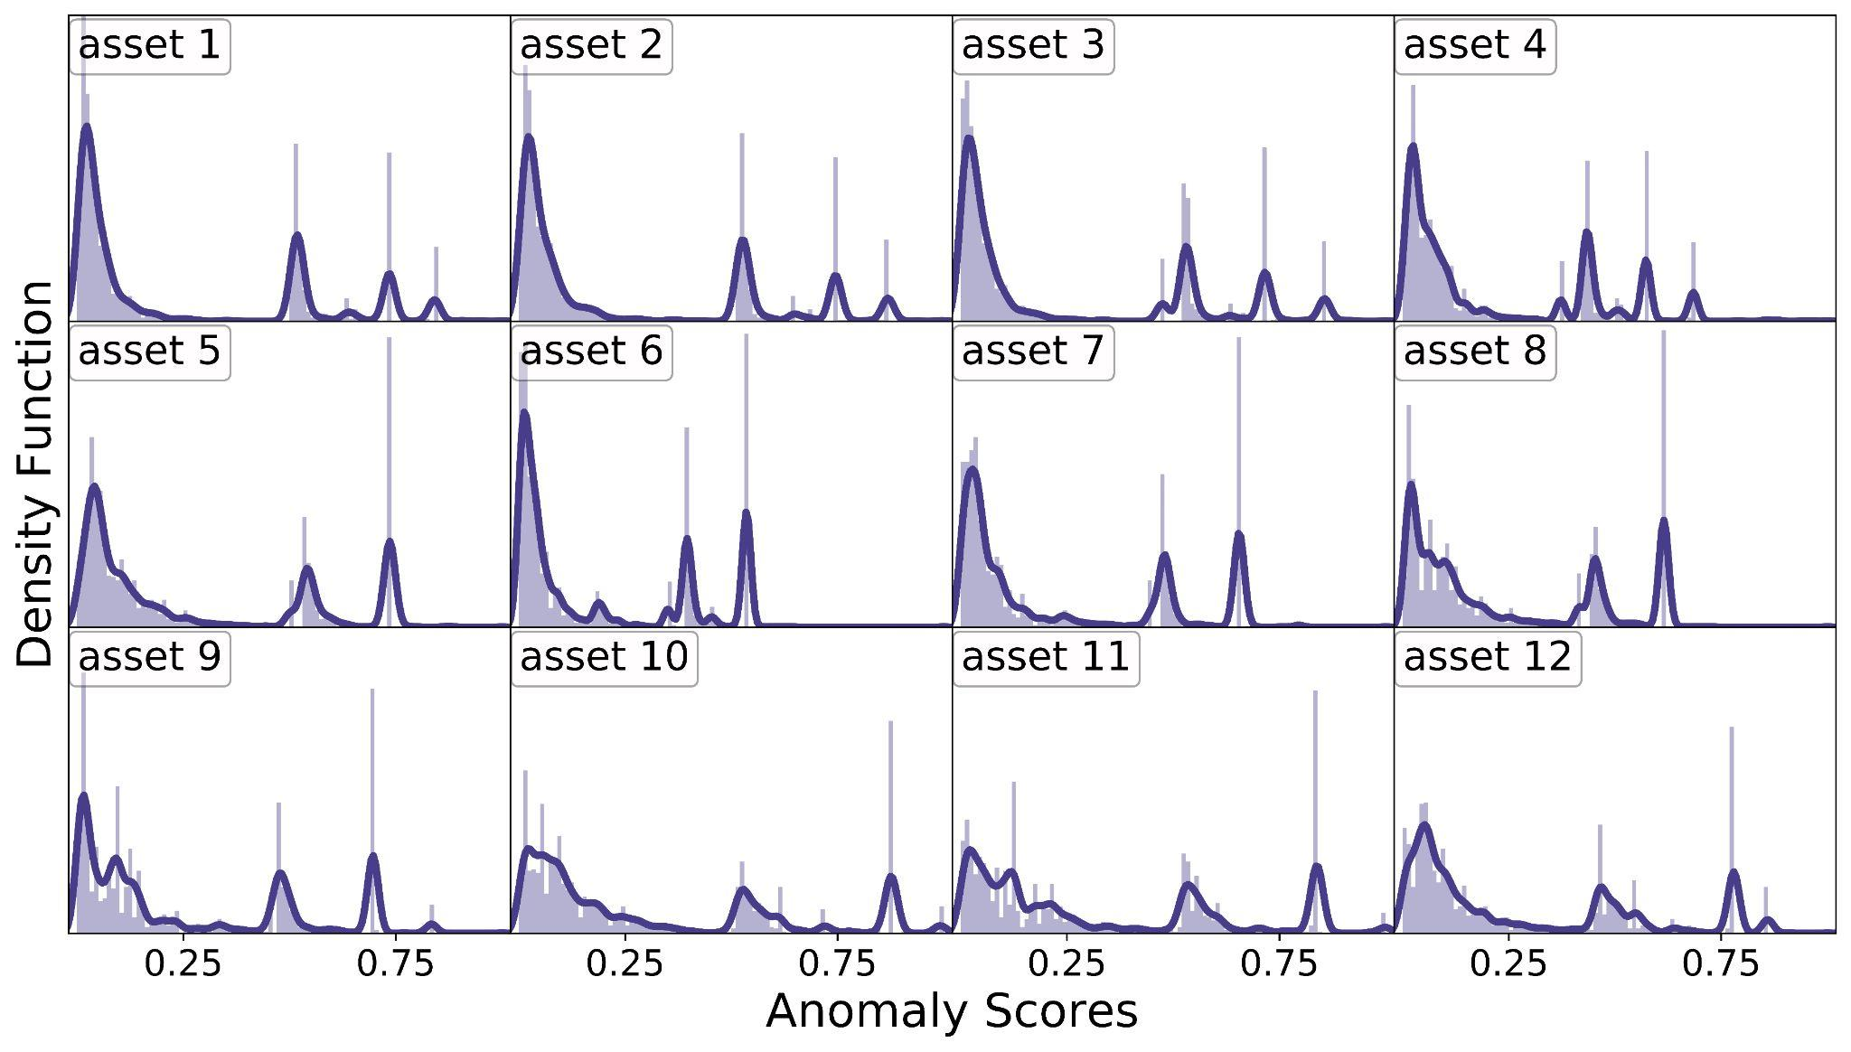
Assumption: normal anomaly scores produced by the same algorithm are similarly distributed
12 proprietary ds
Same anomaly detection algorithm
Notes:
First of all, we want to clearly state and motivate our underlying assumption. We assume that the normal anomaly scores, which are the low scores, follow a similar distribution, where “similar” refers to the shape. In this slide we use the same anomaly detection algorithm to produce the anomaly scores individually for each of our 12 proprietary datasets. As you can see from the plot, although different assets have different peaks when the anomaly scores get higher, for the low scores they show a similar shape. This motivates our methodology to exploit such similarity to transfer the contamination. Let’s now pass to the trade’s four steps.

Slide 13
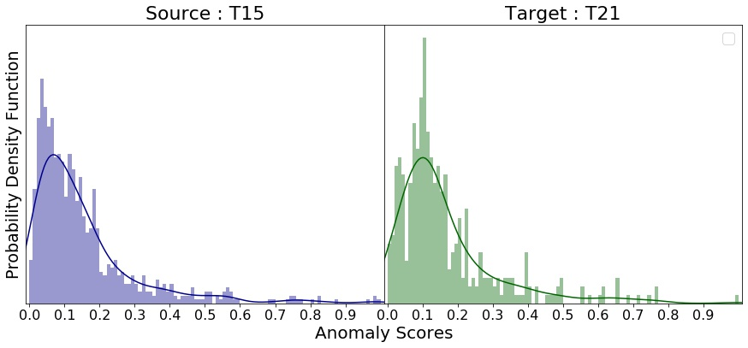
Step 1. Use the same algorithm to compute the anomaly scores of the two domains
Compute the distribution of the anomaly scores of the two separate domains:
Wind turbine 1: source
Wind turbine 2: target
Notes:
First, it uses the given anomaly detection algorithm to assign the anomaly scores to each domain separately. In this way we obtain two distributions of anomaly scores.

Slide 14
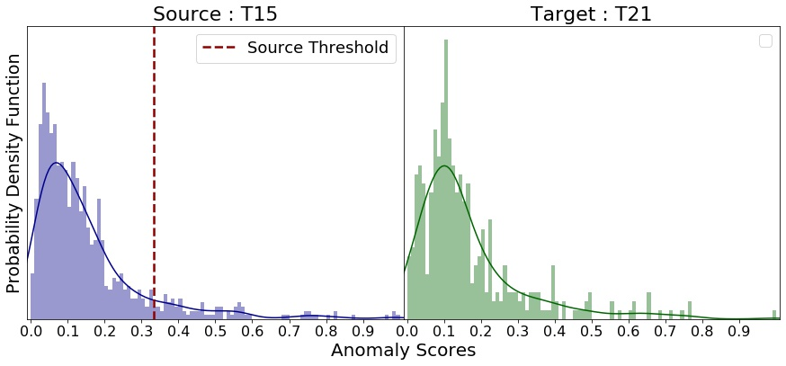
Step 2. Estimate the source predictive threshold
Set a threshold on the source anomaly scores such that the percentage of scores greater than the threshold equals the source contamination factor:
Wind turbine 1: source
Wind turbine 2: target
Source contamination factor
Notes:
Second, it uses the known source contamination to set the source threshold by forcing the proportion of scores above it to match with the source contamination. By doing this, the detector would make the exact amount of predictions for each class.

Slide 15
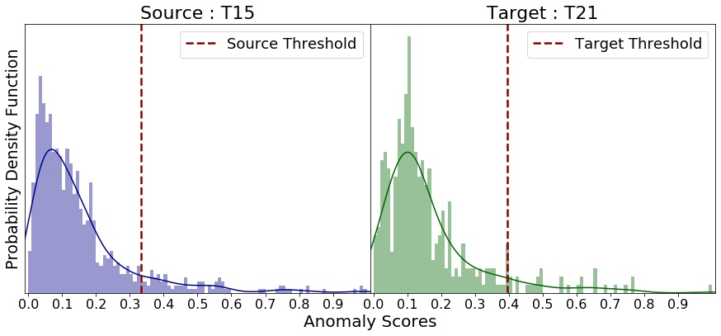
Step 3. Transfer the source predictive threshold
Find the threshold on the target scores such that the shape of the score distributions below the thresholds are as similar as possible:
Wind turbine 1: source
Wind turbine 2: target
Notes:
Once we have the source threshold, TrADe poses an optimization problem: find the best target threshold that maximizes the similarity between the shapes of the scores below the thresholds in the two domains. Essentially, we move the target threshold value and compute the KL divergence between the scores below the target threshold and those below the source threshold. The target threshold value that minimizes such a dissimilarity measure is the one that trade picks.

Slide 16
Step 4. Derive the target contamination factor
Derive the target contamination factor from threshold as in step 2:
Wind turbine 1: source
Wind turbine 2: target
Transfer contamination factor
Notes:
Finally, in the last step TraDe uses the same procedure as in the second step to derive the target contamination from the best target threshold. This means that we consider the proportion of scores above the threshold as contamination factor.

Slide 17
Weighing an ensemble of detectors yields better results
Detectors may produce different scores distributions resulting in inaccurate estimates
TrADe is model agnostic
Ensemble:
Estimate the target contamination using multiple detectors;
Compute the KL divergence between the source and target anomaly scores distribution;
Take a weighted average, where the weights depend on the KL values.
Notes:
However, so far I have never stated what anomaly detector has to be used to compute the anomaly scores. This is because TrADe is a model agnostic approach, meaning that one can use any existing anomaly detector that is able to assign real valued anomaly scores. Though, it may happen that the source and target distribution of scores look quite dissimilar, which may erode the accuracy of the transfer. To overcome this limitation, we propose to use an ensemble of anomaly detectors that work in three steps. First, given an anomaly detector we estimate the target contamination factor using the previous four step approach. Second, we compute the KL divergence between the score distributions of the two domains. Finally, we take a weighted average of the target estimates, where the weight depends on the KL value. In this way we aim to make the target estimate smoother and less detector-dependent.

Slide 18
Theoretical Convergence Analysis
Notes:
Our third contribution is the theoretical convergence analysis of Trade’s behaviour to the limit.

Slide 19
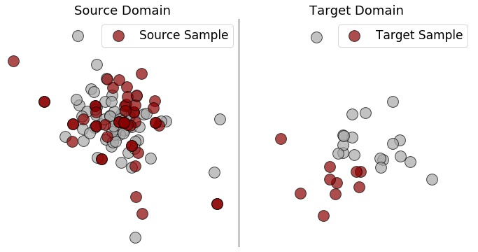
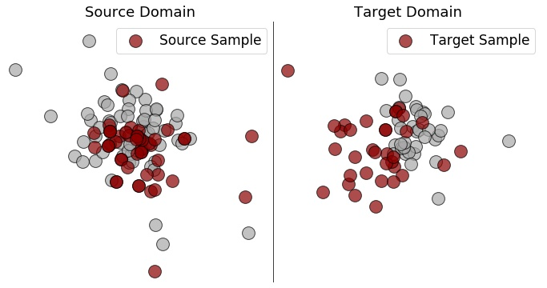
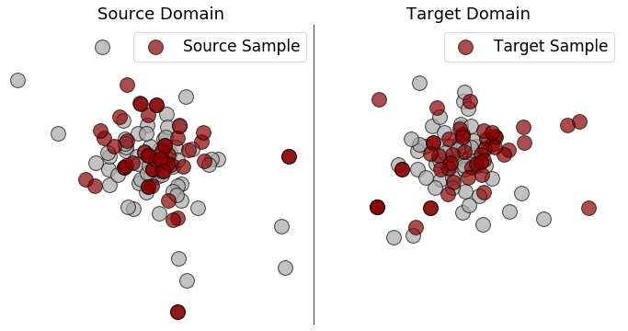
Key assumptions: target gets unbiased & same shape to the limit
The sample from the source domain is representative of its distribution, while the target sample reduces its potential bias when collecting new data;
The source and target normal distributions share the same shape to the limit.
sample size n sample size k
sample size n sample size 2k
sample size n sample size 5k
i.i.d sample biased sample
i.i.d sample less biased
sample
i.i.d sample almost unbiased
sample
Notes:
We started from two hypotheses. First, we assume that the source sample is representative of the source distribution, meaning that it is large enough and i.i.d. Moreover, we assume that the target domain could be biased but when increasing the target sample size the bias fades out gradually, The second assumption is that, to the limit, the shape of the normal anomaly scores distributions of the two domains is the same. This is just a theoretical assumption that allows us to get our final results. In practice, the two shapes do not have to be exactly the same.

Slide 20
Two theoretical results
The estimated target predictive threshold converges to its real value;
The transfer is theoretically well defined and sound (Step 3);
The target contamination factor estimator is unbiased;
Deriving the contamination factor from the predictive threshold returns the expected value (Step 2 and Step 4).
Notes:
In a nutshell, the two results we achieve are the following. First, the estimated target threshold converges to its real value when increasing the target sample size. This means that our step 3 is theoretically well defined and sound. Second, the derived target contamination factor estimator is unbiased, which means that Step 2 and step 4 are motivated as well.

Slide 21
Extensive empirical evaluation
Q1. Does TrADe accurately estimate the target contamination factor?
Q2. Does a more accurate estimate improve the model performance?
Q3. Is an ensemble of detectors more accurate than single detectors?
Q4. How does TrADe perform when varying the source contamination factor?
Notes:
I want to conclude this talk with our extensive empirical evaluation. Essentially, we answered four questions: whether our method estimated accurately the target contamination factor, whether such accurate estimate improves the model performance, how an ensemble of detectors perform against each individual variant, and how trade works when varying the source contamination factor.

Slide 22
Experimental setup
Three groups of datasets:
12 proprietary water consumption, 2 wind turbines, 9 public IoT datasets;
Setup:
Pick a source-target pair (in total 12x11 + 2x1 + 9x8 = 206 pairs);
Estimate the target contamination factor and use it to make predictions;
Baselines:
Source_{Ɣ} and Source_{ƛ} use the source values as target estimates;
Coral aligns the two domains and uses Source_{ƛ};
Unify and Otsu estimate the contamination factor using only the target domain.
Notes:
For this analysis we consider three groups of datasets: 12 proprietary dataset on retail stores about water consumption, 2 wind turbine datasets and 9 public IoT datasets. We consider all the possible pairs within the same group and we do not transfer the contamination between unrelated domains, say for example between a store and a wind turbine, because it never happens in practice. We measure the Mean Absolute Error when estimating the contamination and the F1 score for the model performance. We compare our method with three groups of baselines. Source gamma and Source lambda use the same contamination or threshold as target estimates; Coral is a domain adaptation method that first aligns the two unsupervised domains and then uses the source threshold; finally Unify and Otsu use just the target domain and directly estimate the contamination without using any domain knowledge or labels.

Slide 23
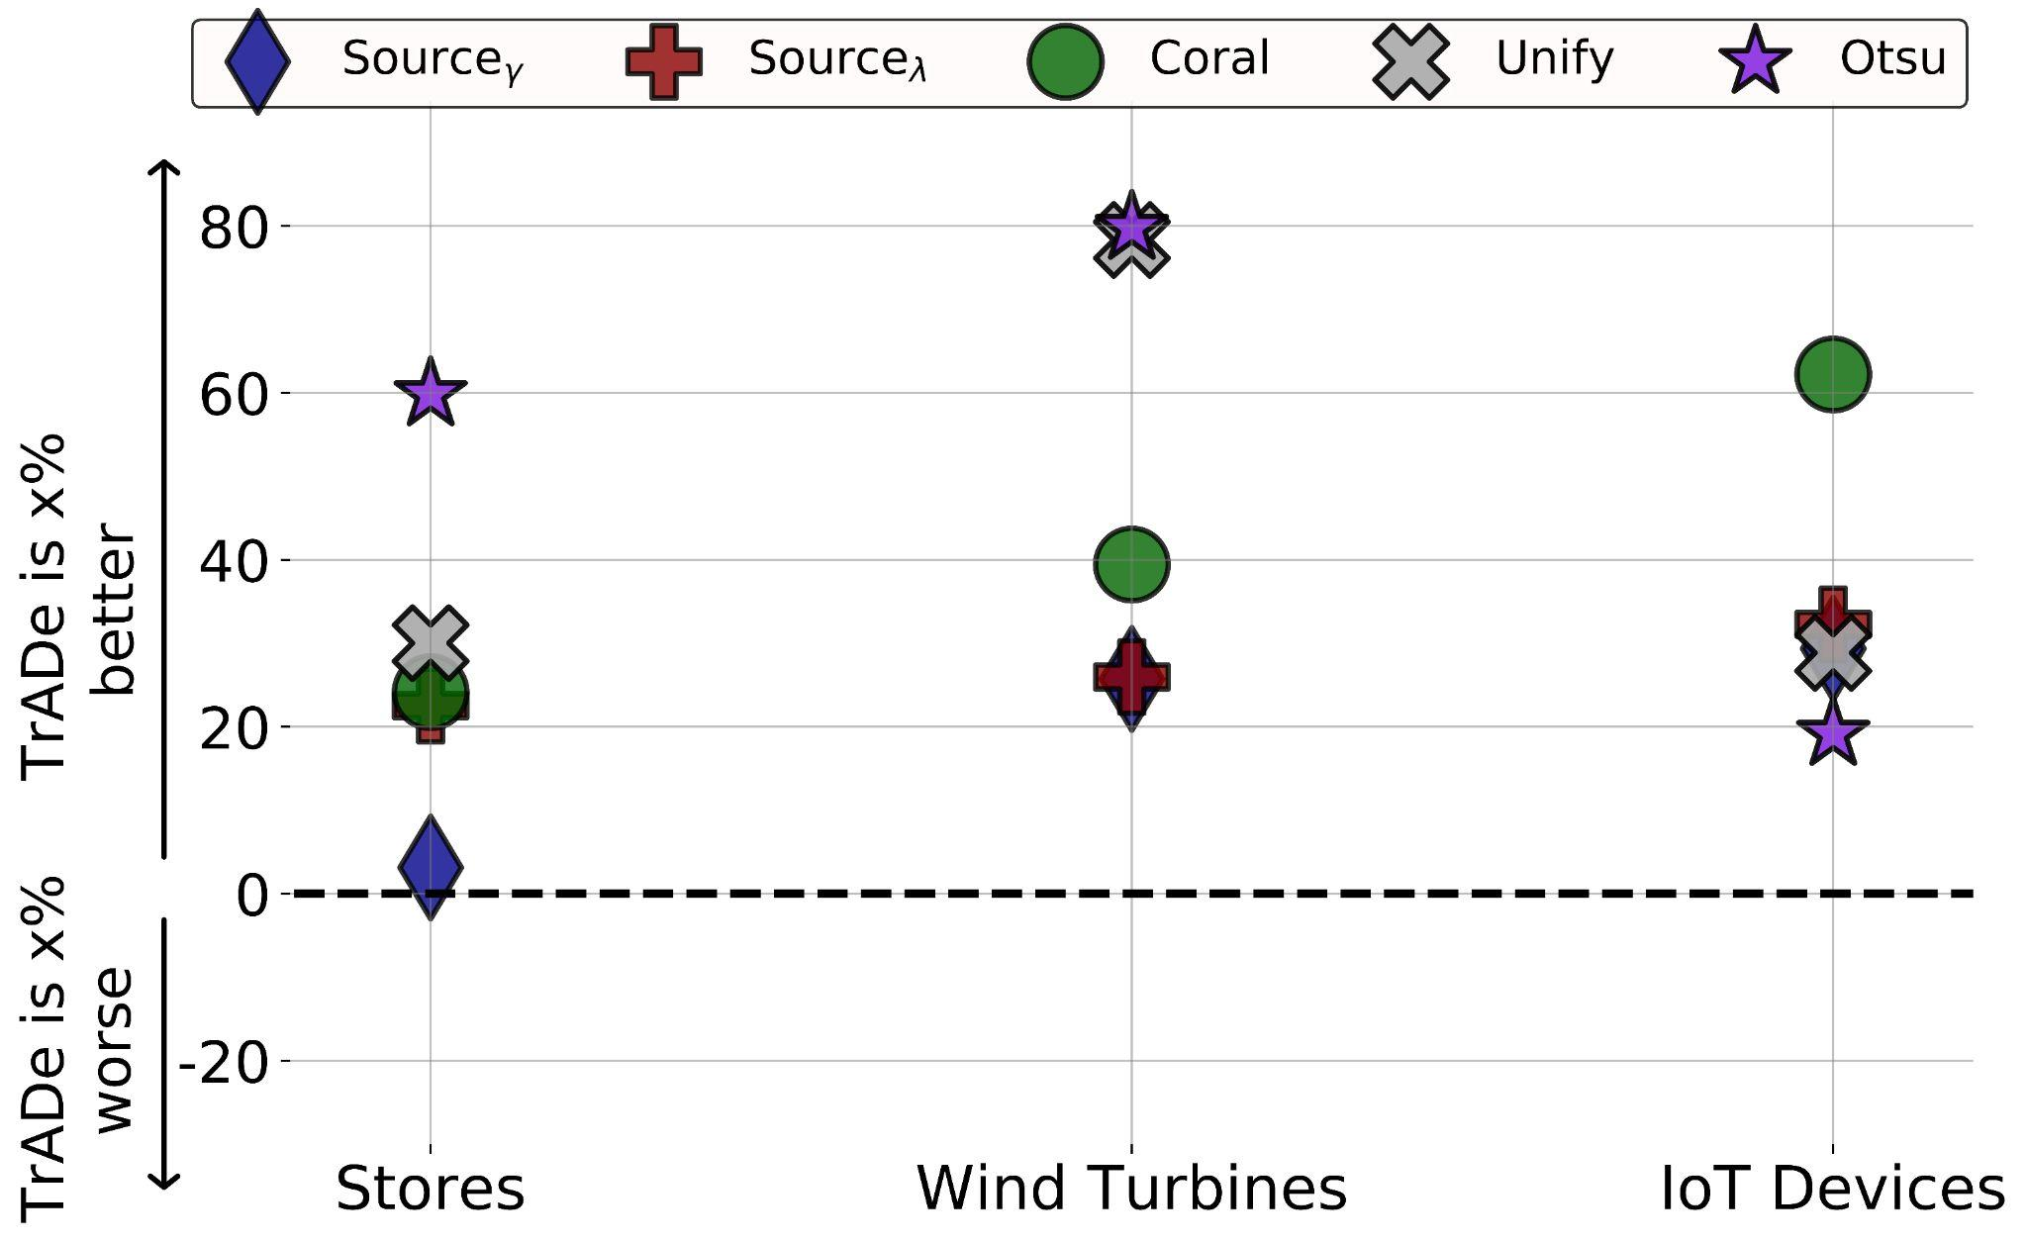
Q1. Does TrADe accurately estimate the target contamination factor?
Average Improvement of the MAE using TrADe against the baselines:
MAE
Aggregated results by
target domain;
dataset group.
Notes:
Our first research question is to investigate whether our method estimates the contamination better than the baselines. We measure the mean absolute error and the average improvement of using our method instead of each baseline. Therefore, positive values in the plot mean that our method is performing better than the baseline. We aggregate results by target domain and, just for clarity, we also aggregate them by dataset group. The plot shows that our method on average estimates the contamination factor better than all the baselines in each dataset group, showing an improvement from around 5% on the store data till around 80% on the wind turbines data.

Slide 24
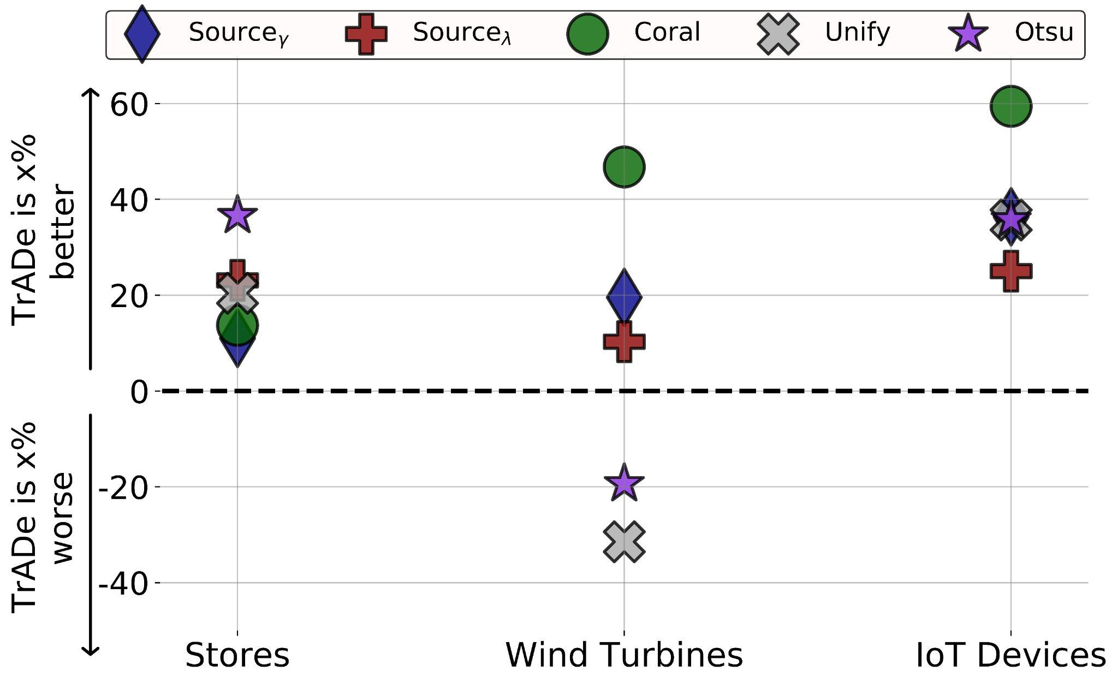
Q2. Does a more accurate contamination factor improve the model performance?
Average Improvement of the F₁ score using TrADe against the baselines:
F₁ score
Aggregated results by
target domain;
dataset group.
Notes:
The second research question is whether a better estimate of the contamination factor improves the model performance. As in the previous case, we measure the average improvement of using our method instead of the baselines. In contrast with the previous slide, using our estimate produces on average better F1 scores both in the store and in the IoT datasets. Regarding the wind turbines, our method does not result in greater F1 scores probably due to the low F1 value that each detector achieves.

Slide 25
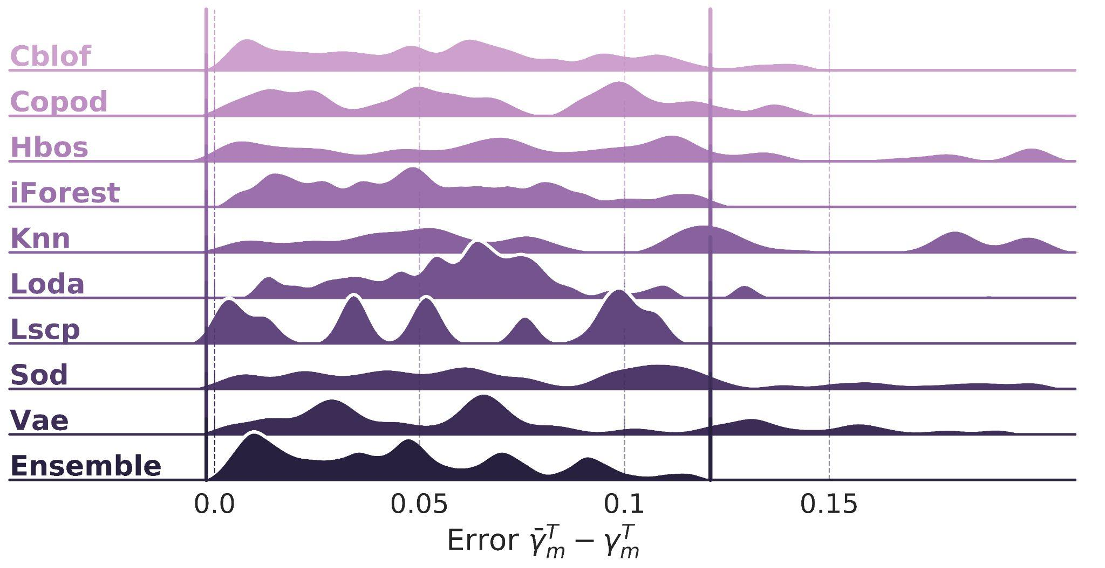
Q3. How does the ensemble perform with respect to each individual variant?
min ensemble
max ensemble
Each TrADe’s variant is named with its anomaly detector
The ensemble shows little variance and limited errors
Notes:
Our third research question investigates whether the ensemble of detectors work better than the individual variants, obtained by using a single detector. In this plot, we show the distribution of the error between our estimate and the real target contamination factor. Each Trade’s variant is named with its anomaly detector name. Compared to using a single detector, the ensemble shows lower variance and limited errors, getting errors higher than .10 in just a few cases. Moreover, the ensemble variant reduces the error on average by at least 10% and up to 50%.

Slide 26
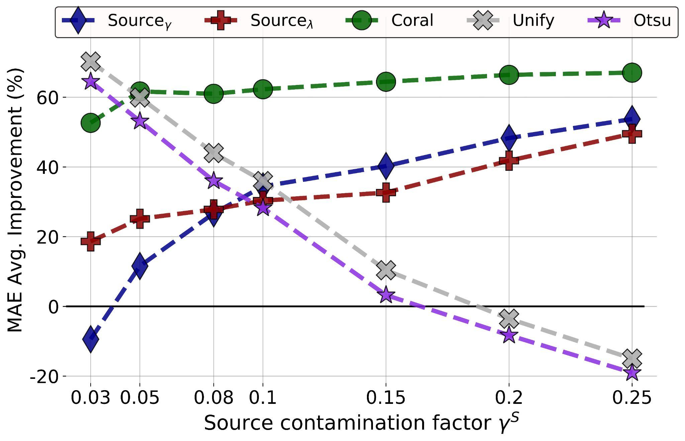
Q4. How does TrADe perform when varying the source contamination factor?
MAE
We aggregate results by target domain and we use only IoT data.
Target contamination fixed to 0.01.
Notes:
Finally, our fourth research question investigates how trade performs when varying the source contamination factor against the baselines. For this experiment we only use IoT data, fix the target contamination to 0.01 and vary the source contamination from 0.03 till 0.25. Compared to Coral, source gamma and lambda, the performance of our method degradates slower when the contamination increases. On the other hand, because Unify and Otsu do not depend on the source contamination, their estimate is not affected by the variation of the source contamination and, therefore, our method becomes worse when the gap gets high.

Slide 27
In conclusion, we
Introduce the problem of transferring the contamination factor;
Propose TrADe, a novel 4-step approach for such a transfer;
Analyze theoretically TrADe’s behaviour to the limit;
Perform an extensive empirical analysis using benchmark and real world data.
Code and experiments are available online: https://github.com/Lorenzo-Perini/TransferContamination
Notes:
In conclusion, we introduce the problem of transferring the contamination factor between related anomaly detection domains, we propose a 4 step approach for such a transfer, we analyze theoretically its behaviour and perform an extensive empirical analysis using benchmark as well as real world datasets. For further information, please check out our paper and use our code available online.

Slide 28
Contact us
name.surname@kuleuven.be
Lorenzo Perini, Vincent Vercruyssen, Jesse Davis
AAAI 2022
https://people.cs.kuleuven.be/~lorenzo.perini/
@LorenzoPerini95
Notes:
If you have any questions, feel free to drop an email. Thanks for your attention.

